Slide 1

Claims Processing Risk & Accuracy Analysis

Slide 2

Project Overview
Objective
The goal of this project is to:
Identify claims that are at risk for processing delays or rework
Evaluate claim accuracy using denial and quality indicators
Analyze key drivers of processing inefficiencies
Provide insights that can improve operational performance and compliance
Business Problem
In healthcare operations, claims that are incomplete, inaccurate or improperly authorized can:
Delay provider reimbursement
Increase administrative workload due to rework
Contribute to higher denial rates
Indicate weaknesses in upstream claim submission processes
This analysis aims to identify risk patterns and operational inefficiencies that may impact claims processing performance.

Slide 3
Data Scope and Analytical Pivot
The initial goal of this project was to evaluate Medicaid claims timeliness performance and develop a claims processing scorecard, similar to those used by regulatory agencies such as CMS and State Medicaid programs.
During data exploration, it was determined that the dataset did not contain the critical data fields necessary to calculate claims processing timeliness.
Examples of missing elements included:
Claims receipt date
Payment date
Completion Date
Regulatory turnaround time indicators
Analytical Pivot: Claims Processing Risk Model
A true claims timeliness metric cannot be directly calculated because the dataset does not include a claim paid, adjudication, or completion date.
Instead of forcing an inaccurate timeliness calculation, this analysis evaluates claims processing risk using available operational indicators. The risk model identifies claims that may require additional review, rework, or follow up based on:
Prior authorization requirements and gaps
Documentation completeness
Claim outcome
Denial category
This approach reflects real-world claims operations because claims with missing authorization, incomplete documentation, or denial outcomes are more likely to experience processing delays or rework.

Slide 4

Claims Processing Risk & Accuracy Analysis
Using Synthetic Medical Claims Data
Healthcare organizations must process claims efficiently and accurately to ensure timely reimbursement, reduce administrative burden, and maintain compliance with federal and state regulations. Inefficiencies in claims processing—such as missing documentation, authorization gaps, or claim denials—can lead to delays, increased costs, and operational risk.
Rather than directly measuring timeliness, this analysis identifies claims that are at risk using key operational indicators.
The analysis is performed using a synthetic medical claims dataset from Kaggle, which has been designed to simulate claim outcomes, payer behavior, prior authorization, documentation completeness, and denial codes while avoiding PHI exposure.

Slide 5
Methodology
Expected Outcome
Data loading and cleaning to ensure consistency and accuracy
Feature engineering to create operational indicators
Development of a claims processing risk model using key variable such as prior authorization, documentation completeness and claim outcome
Statistical analysis to identify differences between low-risk and high-risk claims
Visualization of risk distribution and key drivers
Identify percentage of claims at risk for delay or rework
Outline key drivers of processing risk (prior authorization gaps, documentation completeness
Review claim denial patterns and accuracy indicators
Develop overall claims processing performance insights
This approach focuses on identifying operational inefficiencies and claim quality issues that may contribute to delays and rework.

Slide 6
Technical Implementation & Risk Model Development
Tools Used
Data Science Techniques Applied
Visual Aids Used
Python
Pandas
NumPy
Matplotlib
Seaborn
Jupyter Notebook & Colab
Data Cleaning & Validation
Feature Engineering
Statistical Analysis
Risk Modeling
Dashboard Development
Bar Chart
Horizontal Bar Chart
Heat Map
Executive Dashboard
Risk Classification Logic
Claims were classified as At Risk if one or more of the following conditions were present:
Documentation Completeness < 80%
Denied Claim Outcome
Missing Prior Authorization
Timely Filing Denial

Slide 7
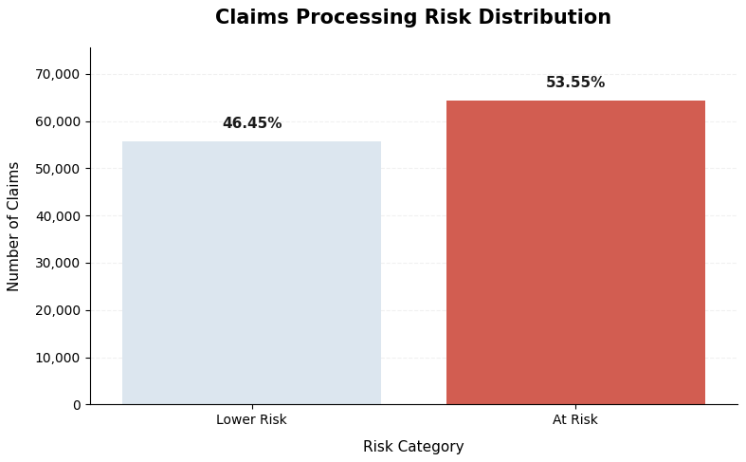
Claims Processing Risk
The chart below shows the number of claims classified as lower risk compared to claims at risk for delay or rework.
This analysis compares key operational indicators across claims processing risk categories to determine whether high-risk claims exhibit characteristics associated with processing delays, rework, or denial.
Claims classified as “Lower Risk” do not exhibit any of the identified processing issues.
Claims classified as “At Risk” have one or more of the following conditions present:
Missing or incomplete prior authorization
Documentation completeness below threshold
Denied claim outcome
Timely filing deficiencies
Key Findings:
Total claims analyzed: 120,000
Lower-Risk claims: (46.45% - 55,740)
At-Risk claims: (53.55% - 64,260)
Business Interpretation:
More than half of all claims were identified as having at least one operational risk factor. This suggests that documentation quality, authorization compliance, and denial prevention represent significant opportunities for process improvement and operational efficiency

Slide 8
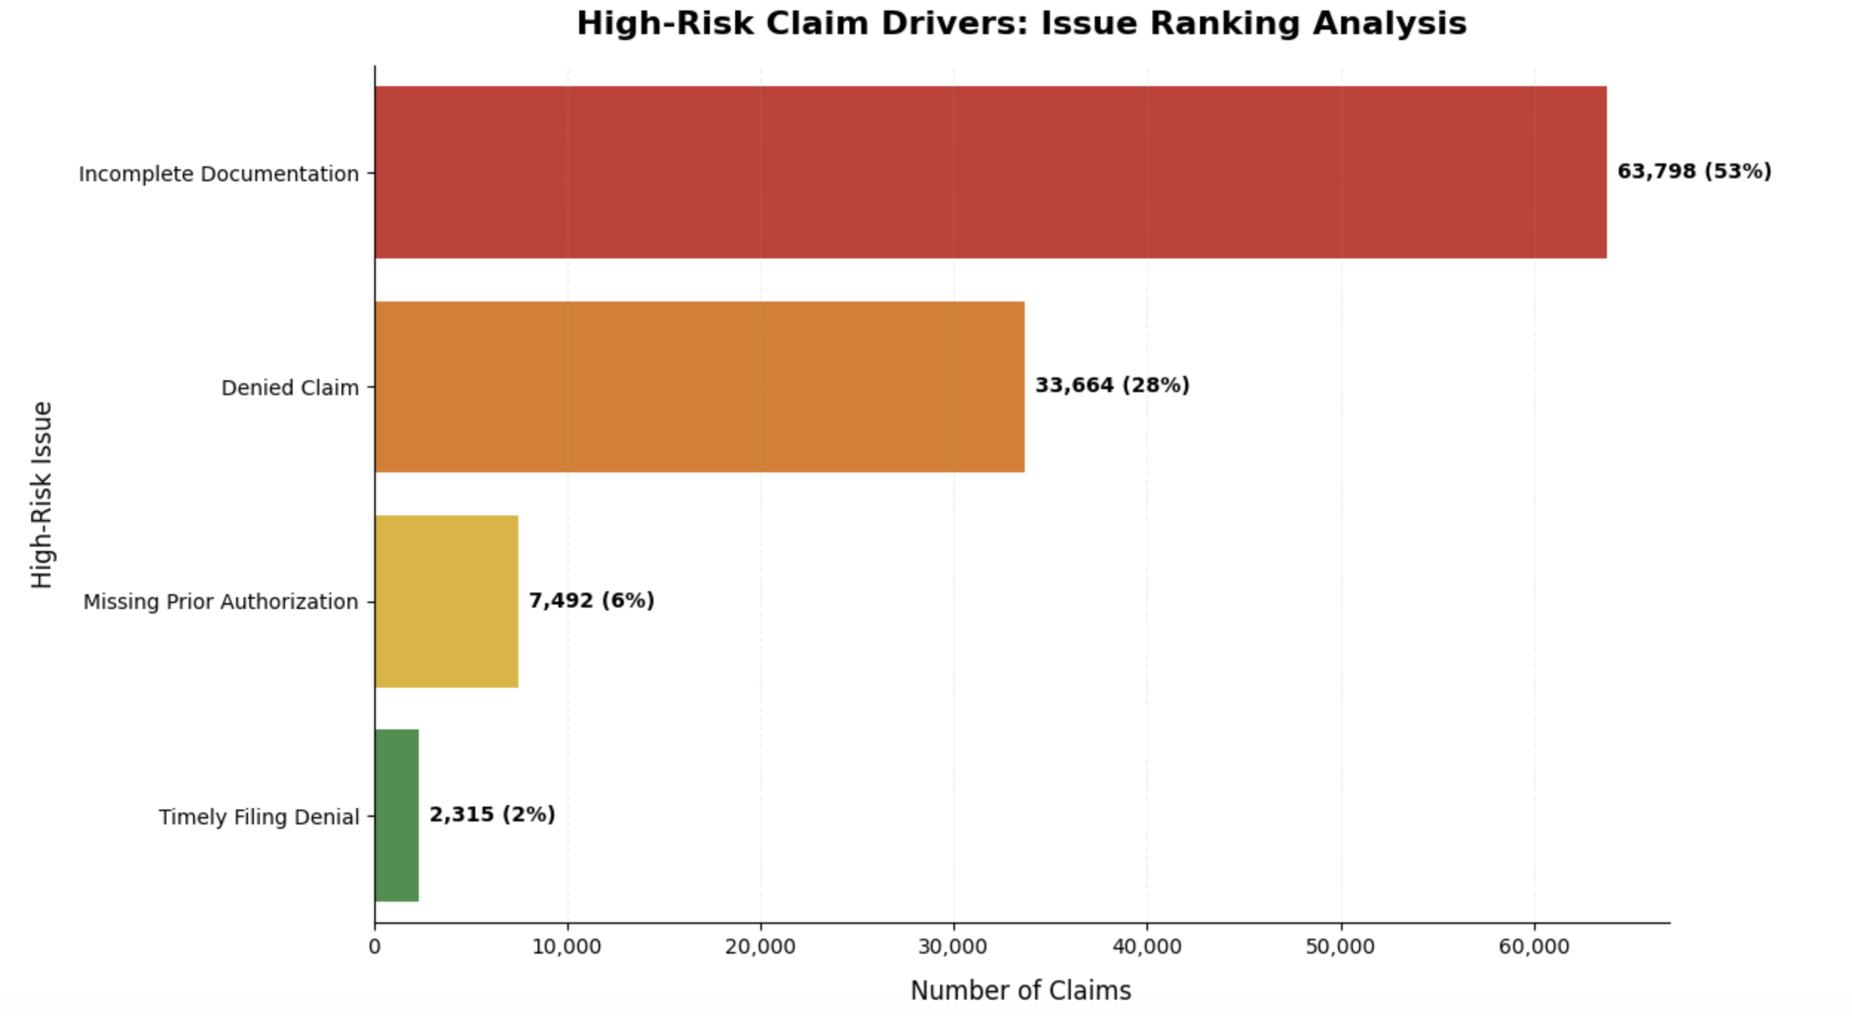
At-Risk Analysis
This chart presents the issue counts for claims categorized as “At Risk”, highlighting the specific problems that contribute to their higher risk classification.
These are the issues that drive claims into the high-risk category:
Incomplete Documentation
Denied Claims
Missing Prior Authorization
Timely Filing Denial
Impact:
The analysis demonstrates that documentation quality is the dominant risk driver, with denial outcomes representing the second largest risk factor, indicating deficiencies are strongly associated with:
Increased manual review
Claim rework
Higher denial exposure
Increased administration cost

Slide 9
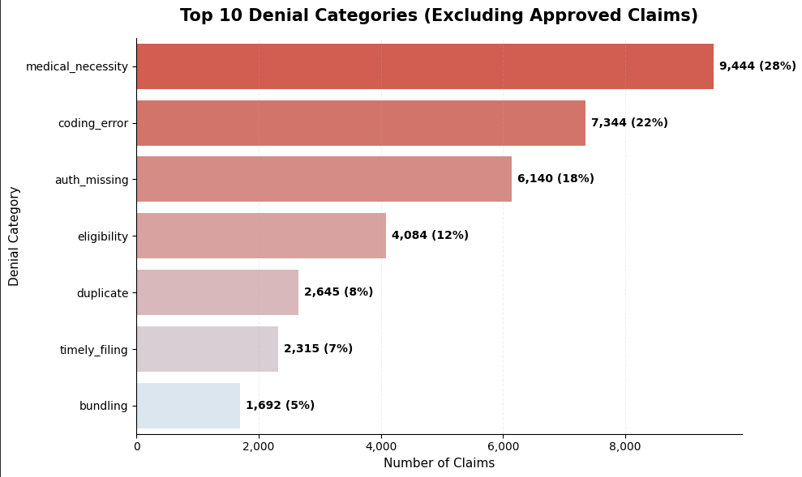
Denied Claim Overview
This analysis examines the primary denial categories contributing to the overall denial rate of 28% for High-Risk claim drivers.
Understanding the root causes of denied claims allows healthcare organizations to focus corrective actions on the most preventable denial drivers.
Primary Drivers:
Medical Necessity
Coding Error
Missing Authorization
Together, these three categories account for approximately 68% of all denied claims.
This suggests that improvements in clinical documentation, coding accuracy, and authorization management could substantially reduce denial volume and improve overall claims performance.

Slide 10
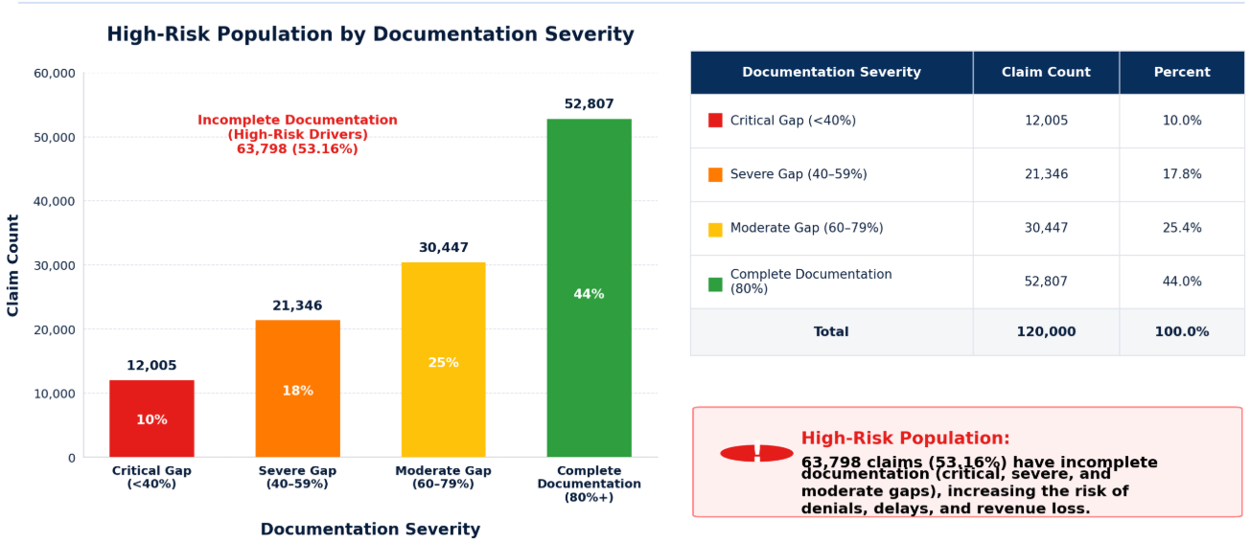
Incomplete Documentation Overview
Documentation completeness was identified as the largest contributor to claims processing risk. This analysis evaluates the severity of documentation deficiencies across the claim population to determine where operational improvement efforts should be focused

Slide 11
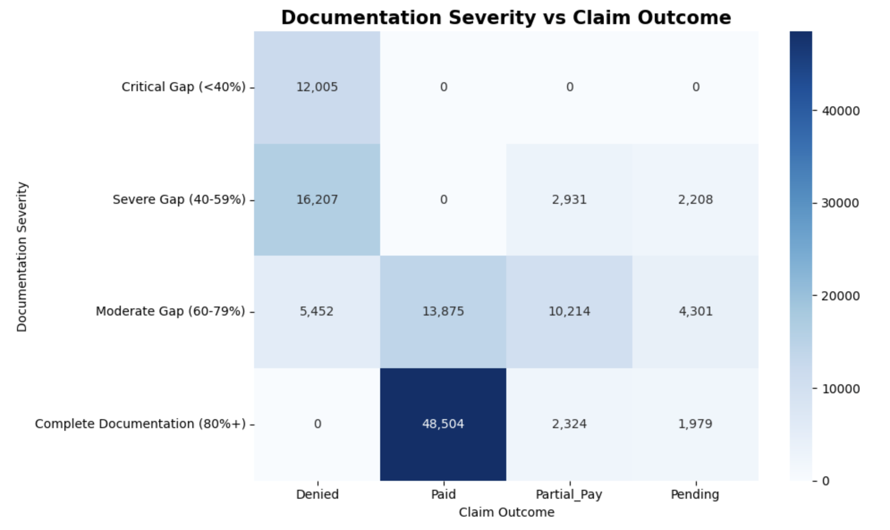
Relationship Between Documentation Completeness and Claim Outcomes
HEAT MAP
Claims with Critical Documentation Gaps experienced the highest denial rates, while claims with Complete Documentation generated the highest paid outcomes.
This demonstrates a strong relationship between documentation quality and claims processing success.
This finding validates documentation completeness as the strongest operational risk factor identified in the analysis and demonstrates the importance of improving documentation quality before claim submission.
Poor Documentation → Denial Risk Complete Documentation → Payment Success

Slide 12

Statistical Validation of Documentation Impact
Contingency Table
Statistical Test Performed
A Chi-Square Test of Independence was conducted to evaluate the relationship between documentation quality and claim outcomes.
Outcome | Denied | Paid | Partial_Pay | Pending
Documentation_Severity
Critical Gap (<40%) | 12,005 | 0 | 0 | 0
Severe Gap (40-59%) | 16,207 | 0 | 2,931 | 2,208
Moderate Gap (60-79%) | 5,452 | 13,875 | 10,214 | 4,301
Complete Documentation (80%+) | 0 | 48,504 | 2,324 | 1,979
Results:
Chi-Square Statistic: 106,271.33
Degrees of Freedom: 9
P- Value: <0.001
* In a Chi-Square Test, the Degrees of Freedom (df) represent the number of values that are free to vary once the row and column totals are fixed. The Degrees of Freedom formula is df=(r-1)(c-1), in this case we are calculating 4 rows (r-1) and 4 columns (c-1).
*The p-value measures the probability that the relationship observed in the data occurred by random chance. Most statistical test use: Significance Level (a) which is a = 0.05, this means we are willing to accept a 5% chance of being wrong.
In this case the p-value is p<0.001, which is well below the standard significance threshold of 0.05. Therefore, we rejected the null hypothesis.
Key Findings:
Because the p-value is significantly less than 0.05, the null hypothesis was rejected. This confirms a statistically significant relationship between documentation completeness and claim outcomes.
The heat map identified a clear relationship between documentation quality and claim outcomes. This Chi-Square Test of Independence statistically validates the observation, confirming claims with critical and severe documentation gaps are substantially more likely to be denied, while claims with complete documentation are significantly more likely to be paid successfully.
Notes:
The Chi – square statistic is extremely high (106,247.33) which is rare. Indicating that the observed differences are substantial, this means claims with poor documentation behaved very differently from claims with complete documentation.

Slide 13
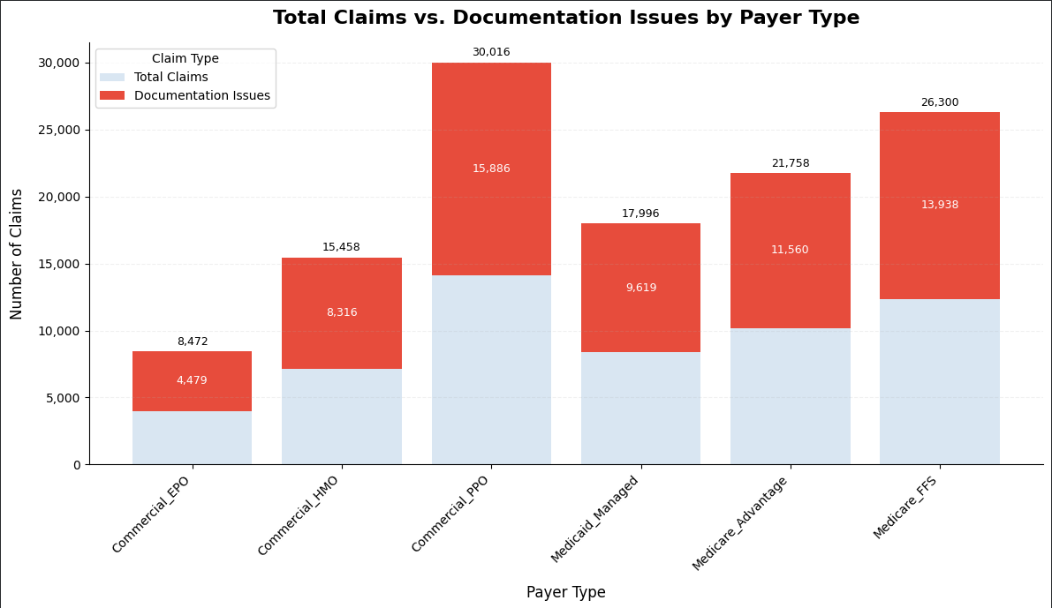
Documentation Deficiencies Across Payer Type Overview
This analysis examines how documentation deficiencies are distributed across payer types to identify where operational risk is most concentrated.
Understanding payer-specific documentation patterns helps prioritize quality improvement efforts and resource allocation.
The largest concentrations of documentation deficiencies were observed in:
Commercial PPO
Medicare FFS
Medicare Advantage
These payer segments represent the greatest opportunity for documentation quality improvement and risk reduction.

Slide 14
Recommendations
Improve prior authorization validation before claim submission
Increase documentation completeness standards
Monitor high-risk claims to reduce rework and delays
Analyze denial categories to reduce preventable denials
Implement pre-submission quality checks
Expected Outcome
These actions can help improve operational efficiency, reduce administrative burden, and enhance claims processing performance.

Slide 15

Conclusion
This capstone project demonstrates how claims data can be used to evaluate processing risk, denial trends, and financial impact. By cleaning the data, engineering useful fields, calculating denial rates, analyzing risk drivers, and building a scorecard-style dashboard, the project shows how data analytics can support healthcare operations and compliance monitoring.
The final analysis reflects real-world scorecard concepts used to identify risk, improve operational performance, and strengthen oversight.

